Slide 1



CMSI 1900
11/5/24
Welcome to CPD!
Career and Professional Development (CPD)
Charles Von der Ahe Suite 135
careers.lmu.edu

Slide 2

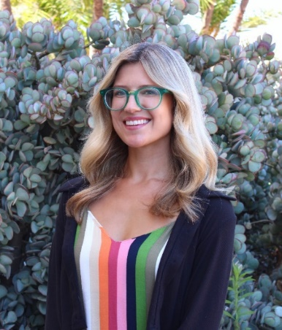
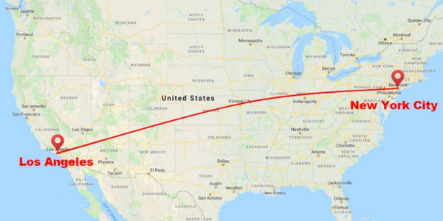
Introductions
Erika Zocher, M.S.
Assistant Director of STEM Professions
erika.zocher@lmu.edu

Slide 3




  Office located in VDA 135
  Services such as personalized career coaching with a designated coach in your industry (EZ)
  Free access to platforms, advanced technology and resources to help you with your resume, cover letter, interviewing, search, and more
  Curated career fairs and events to connect you with employers and LMU alumni
  A dedicated Employer Engagement team sourcing top companies in all LMU affiliated industries and fields
  An exclusive job board filtered to your career interests and preferences

Slide 4

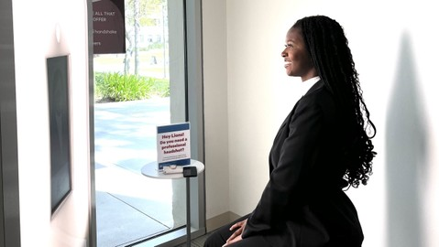

Services
Career Coaching: Resume/cover letter/grad school application review, mock interviews, career exploration, job/internship search
Professional Portraits: Self-service photo booth
Mane Apparel: Rent appropriate attire for career fairs, interviews, networking, and professional portraits. Inventory includes suits, blazers, skirts, button-down shirts, and more. The only cost to students is a cleaning fee after use.

Slide 5
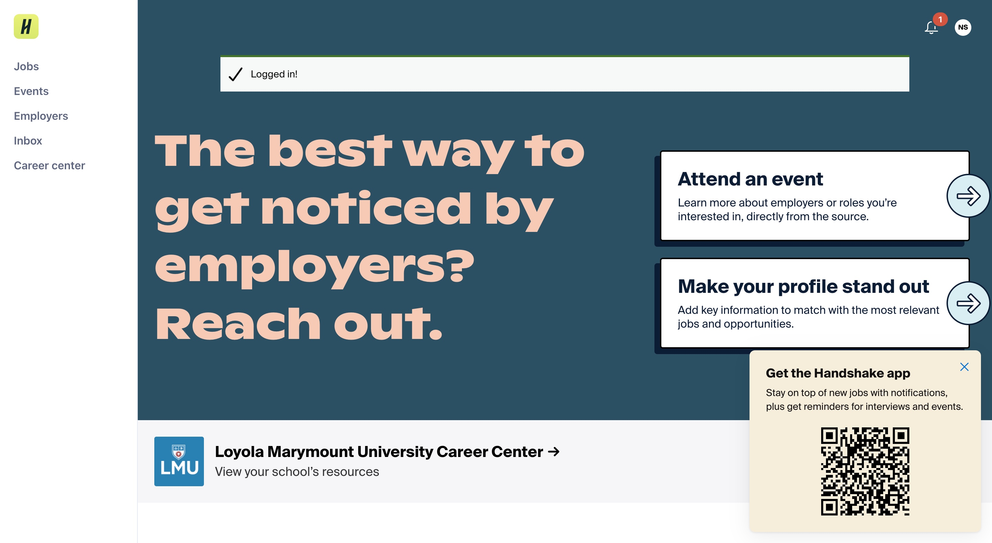
Platforms
Handshake:
Find jobs and internships
Register for events
Book coaching appointments at CPD

Slide 6

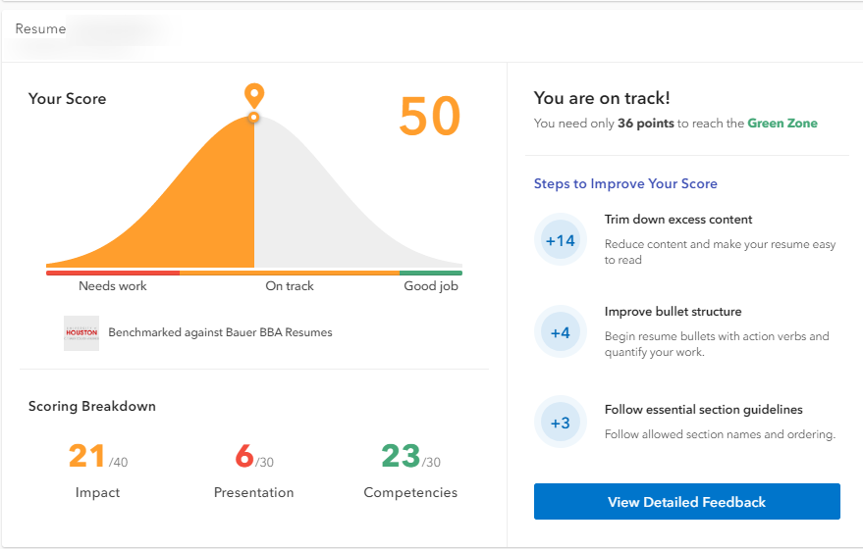
Platforms
Vmock: 24-7 online resume-review tool, leveraging AI technology

Slide 7
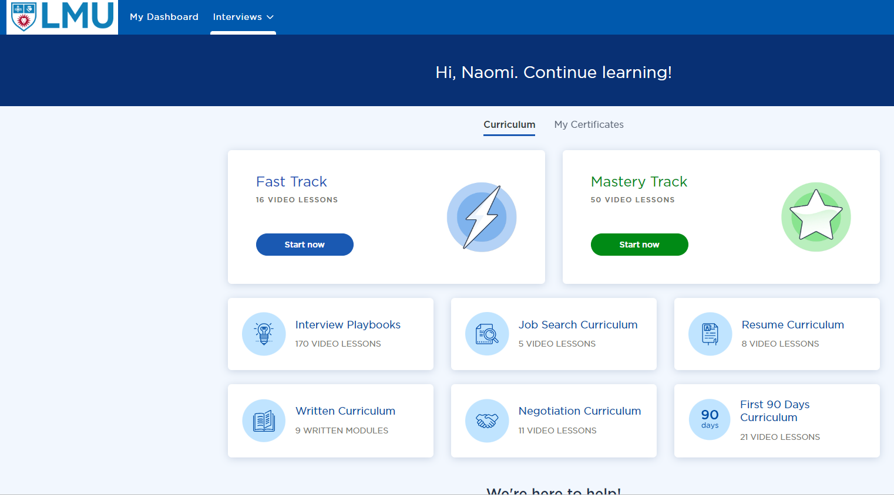
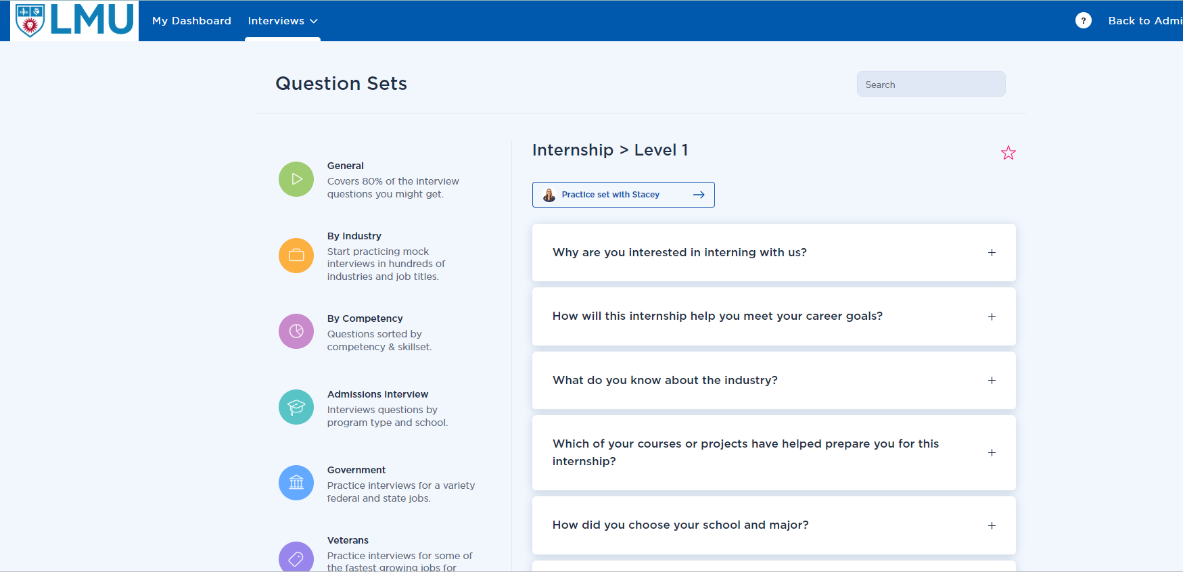
Platforms
Big Interview: On-demand access to interview practice and a library of pre-recorded interview questions categorized by industry, competency, and circumstance to refine your in-person and virtual interviewing skills.
Hundreds of training videos
Thousands of interview questions
Technology providing personalized feedback using AI

Slide 8
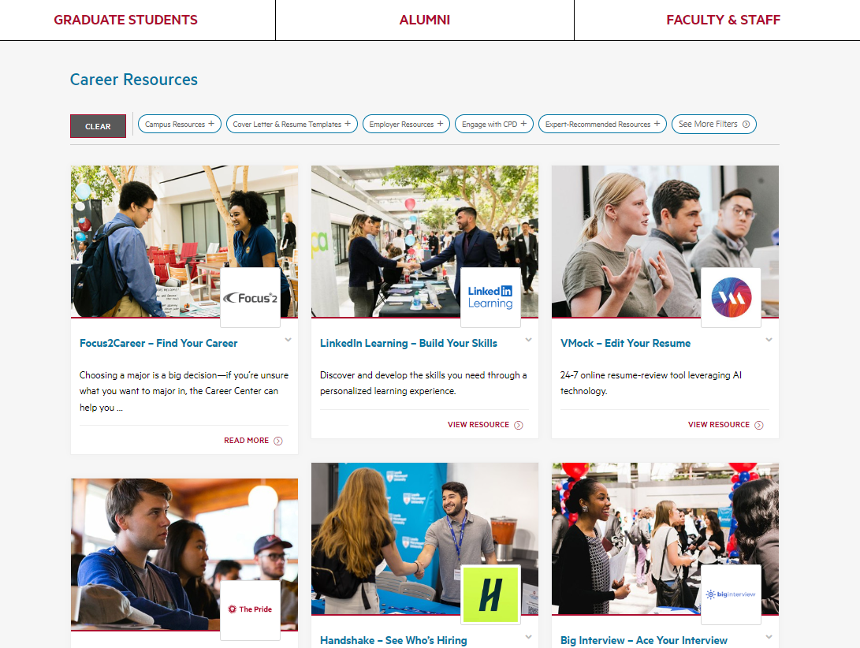
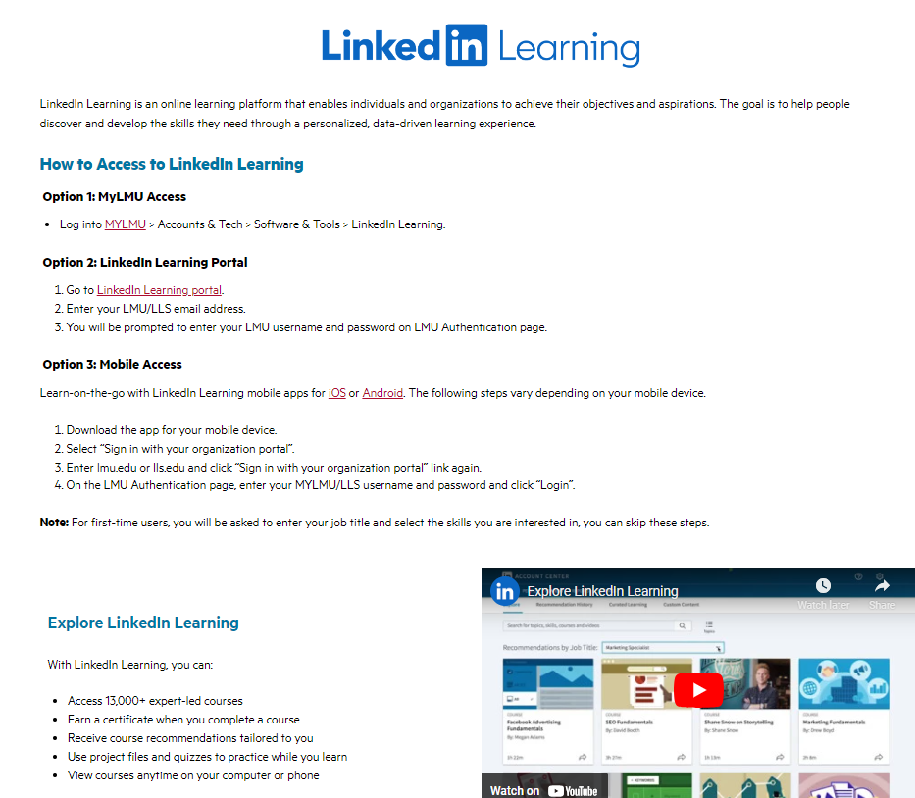
Platforms
LinkedIn Learning:
Industry-related courses
Certificates on popular topics and technology
Showcase skill and industry knowledge
Feature accomplishments on resume and LinkedIn profile

Slide 9
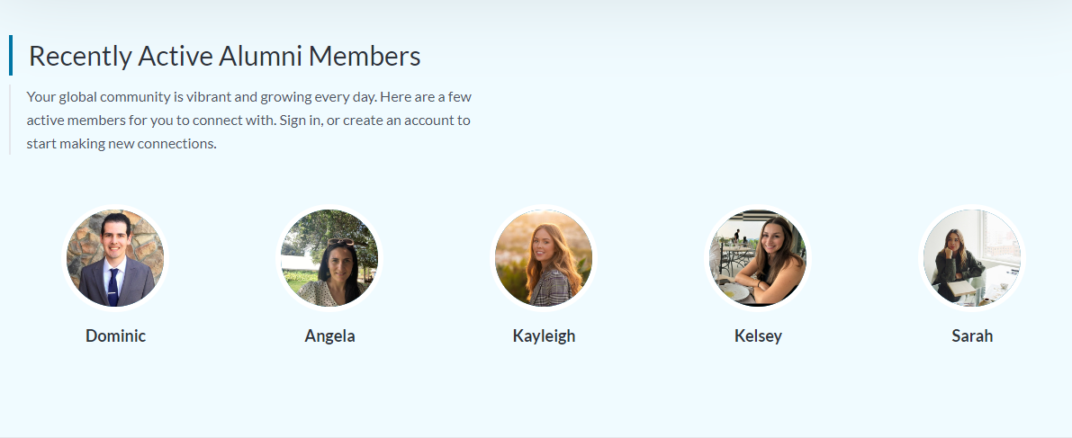
Platforms
The Pride
LMU’s Exclusive Mentorship Platform
Connect with alumni for career guidance and advice

Slide 10
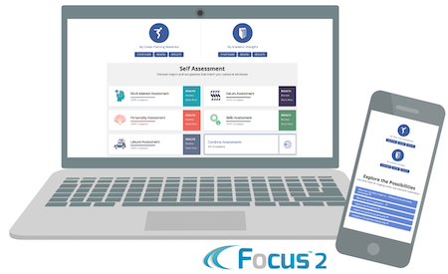

Other Resources
Academic Internship Credit
  ICSE 2100
  Available fall, spring, & summer
Summer Internship Funding
Career Assessments

Slide 11


Events
Career Fairs
  Casual Career Conversations: TOMORROW 11am – 3 pm
Info Sessions
Professional Development Workshops
Networking opportunities
Cross-campus collaborations
Career Treks

Slide 12
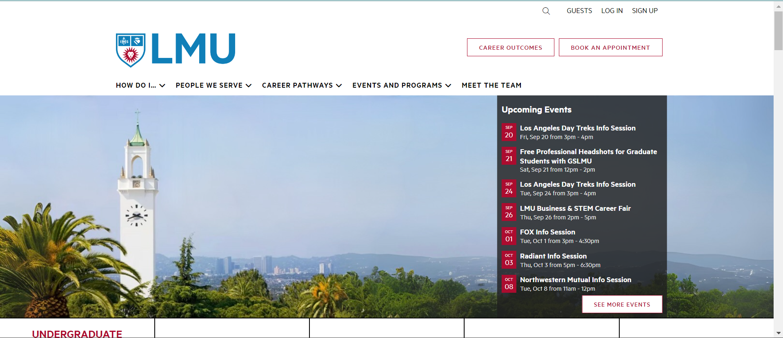

Visit Our Website
https://careers.lmu.edu

Slide 13
INTERNSHIPS
How do I find and prepare for internships in tech?
How can CPD help?

Slide 14
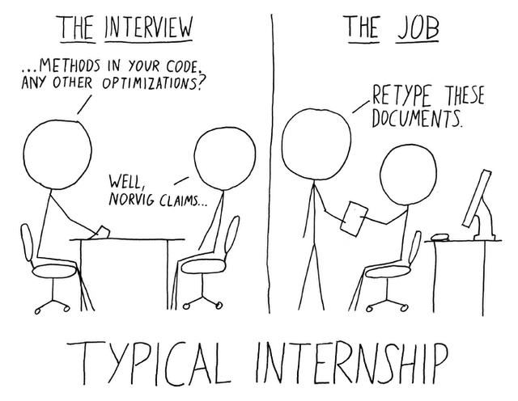
Benefits of internships/professional experience during college
Gain practical skills, start applying what you are learning in class
Strengthen your resume
Become a more competitive applicant
Learn about what you do or do not want to pursue, what type of work environment is right for you

Slide 15
Finding Internships
Handshake
LinkedIn
  Jobs Page
  NETWORKING: Connect with alumni and others, ask for informational interviews, tips, and suggestions
Tap into the “hidden job market”
  Contact companies, organizations, individuals about opportunities that are not yet posted → “Do you know of any positions opening soon?”
Attend career fairs and info sessions on campus
Attend networking events and conferences off campus
Join organizations
Talk to faculty
Start early!

Slide 16
Preparing for Internships
Make a coaching appointment to discuss your options, get help with your application materials, and prep for interviews
Use platforms on CPD website: Vmock, Big Interview
Tap into your networks, seek mentors
Do your research
Make the most of your coursework
  Choose meaningful projects and take ownership
Learn about company culture and expectations
Be curious
Practice patience and resilience
Know your why

Slide 17
What do tech employers look for in candidates?*
Questions to address when applying for a job or internship:
Problem-solving skills
Critical thinking skills
Innovation/ability to think outside the box
Communication skills
Attention to detail
Curiosity
Teamwork and leadership
Why this company/organization?
What am I bringing to the table/what value will I add/how will I forward the work/mission?
*Weave these skills into your experience descriptions in your resume and address in your cover letter. Compare with the job description and the company mission to be sure you address all the qualifications they are looking for.

Slide 18
FAQs
Should I get an internship? YES
Do I have to customize my resume for every application? YES
Should I write a cover letter? YES
Can I get an internship with no experience? YES
Should I use ChatGPT to write all my application materials? NO
Should I pursue a graduate degree? DEPENDS

Slide 19
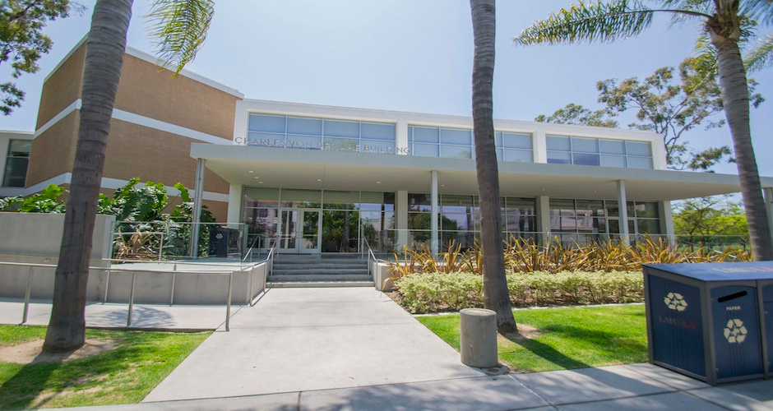


Questions?
careers@lmu.edu
erika.zocher@lmu.edu
310-338-2871
Career and Professional Development (CPD)
Charles Von der Ahe Suite 135
careers.lmu.edu

